Slide 1
Mobile GIS - Location Based Services 2024
Group Members:
Moritz Aberle
Renuka Ganugula
Theodore Kapler
Valentin Tobias Jung

Slide 2
I- A closer look to the chosen Frame work

Slide 3


Slide 4

Prog Language : Java script
Owner : Facebook
Performance : High
Opensource : Yes
Users : Active community

Slide 5
II – Reason Behind choosing React Native

Slide 6
React Native is a JavaScript framework that allows developers to build native mobile apps for iOS and Android platforms using a single codebase.
By utilizing a single codebase, React Native significantly reduces development time.
Smart Recompiling: When developers make changes in code base. React Native's hot reloading feature detects this change.
Code Reusability : These components for UI/UX functionalities developed once and then reused across different parts of the application or even in entirely different projects.
This helps in maintaining coherence and consistency.

Slide 7
III – Some Real world examples of using React Native

Slide 8

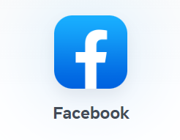
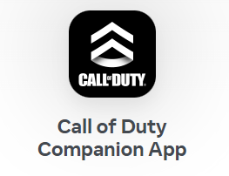
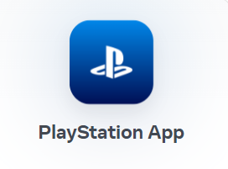
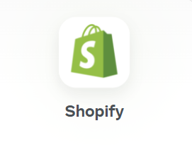


Slide 9
IV – Theme behind developing our application

Slide 10
We're developing a GIS app focused on showcasing
under rated visiting places/tourist spots and cultural landmarks in our area.
“With intuitive navigation and vivid visualizations guiding users to easily discover and explore hidden gems and enrich their travel experiences.”

Slide 11
V – Few Disadvantages of React Native.

Slide 12
Some platform-specific features or UI elements may require custom native code implementations, adding complexity.
React Native may not provide access to all platform-specific APIs or functionalities available in native development environments.

Slide 13
Thank You!

